Slide 1
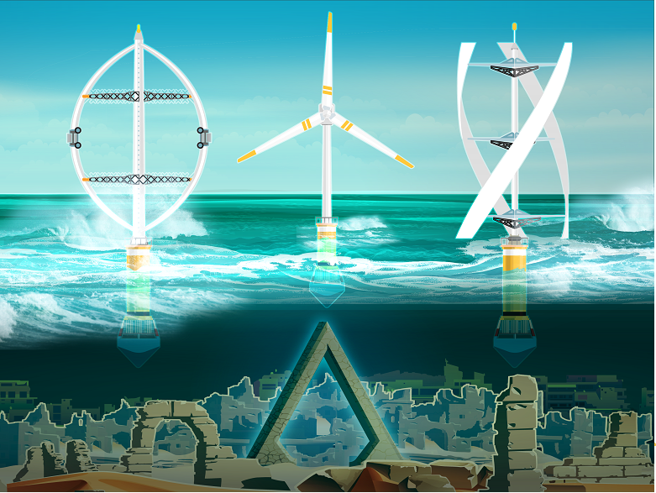






Ultraflexible Smart FLoating Offshore Wind Turbine (USFLOWT)
Model Linearization
David Stockhouse
Aoife Henry
Manuel Pusch
Oct. 8, 2021
https://arpa-e.energy.gov/?q=arpa-e-programs/atlantis

Slide 2
Overview
Inputs and Outputs
Excitation Signals
Model Error Metrics
Simulation Setup
Preliminary Results
Highlighted Issues

Slide 3
Inputs and Outputs
Main Inputs (to be excited)
horizontal wind (uniform)
blade pitch (collective)
generator torque
cable tension (collective)
etc.
Main Outputs (to be evaluated)
generator speed
generator power
platform pitch
tower base moment
blade root bending moment
drive train torque
etc.
Notes:
Other inputs: yaw angle, wave, wind shear, etc.

Slide 4
Excitation Signals
Types
step
ramp
sine
sweep
noise
Parametrization
amplitude
frequency / bandwidth

Slide 5
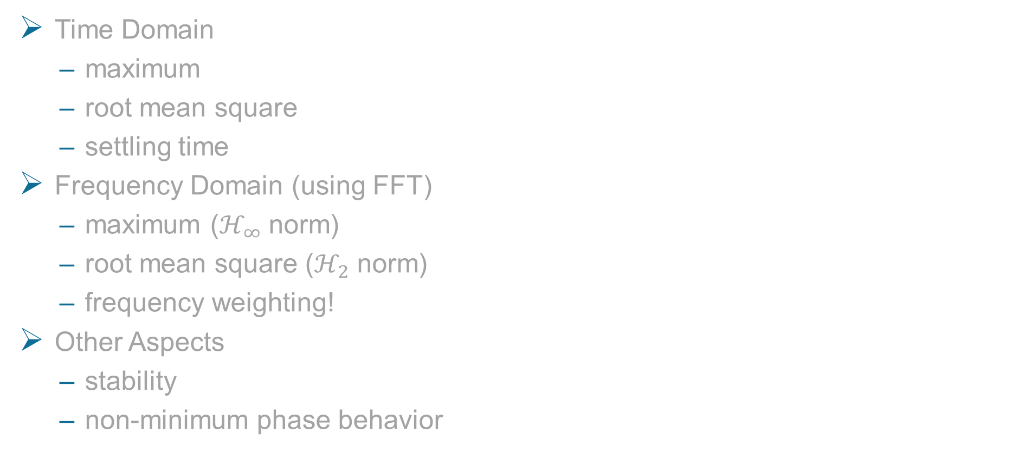
Model Error Metrics
Time Domain
maximum
root mean square
settling time
Frequency Domain (using FFT)
maximum ($ℋ_{∞}$ norm)
root mean square ($ℋ_{2}$ norm)
frequency weighting!
Other Aspects
stability
non-minimum phase behavior

Slide 6
Simulation Setup
Open-loop (assuming open-loop stability)
Without leaving proximity of operating point
Frequency response comparison
How accurate is the linear model for various frequencies/amplitudes?
Closed-loop
Step disturbance
Test difference of linear/nonlinear control response
From how large a step can the system recover?
Small-scale DLC

Slide 7
Preliminary Results: Linear Model Analysis
Structure of Matrices
state coupling
Model Order Reduction
Minimum Realization
Instability contribution
MANUEL

Slide 8
Preliminary Results: Comparison Linear / Nonlinear Model
plots comparing time series?
evaluation/visualization of some error metrics?

Slide 9
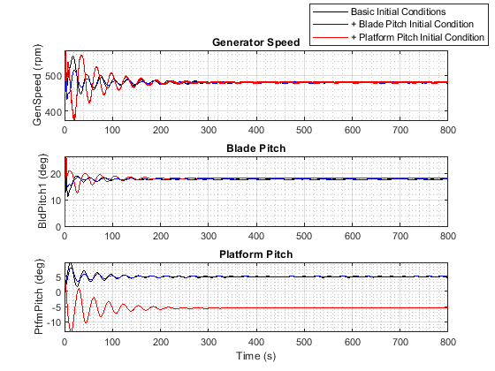
Highlighted Issues
HydroDyn states, including wave input, in linear model?
Set (steady state) initial values for nonlinear simulation (OpenFAST)?
problem with platform pitch angle
Linearized models have unstable poles

